Slide 1
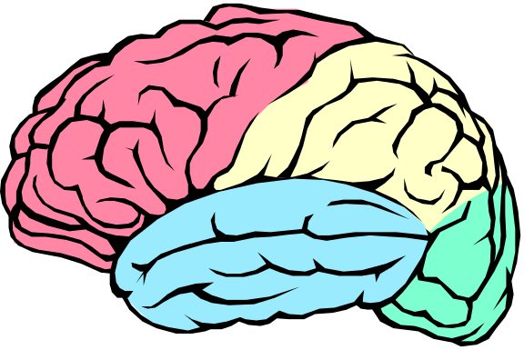
The Nervous System
A network of billions of nerve cells linked together in a highly organized fashion to form the rapid control center of the body.
Functions include:
  Integrating center for homeostasis, movement, and almost all other body functions.
  The mysterious source of those traits that we think of as setting humans apart from animals

Slide 2
Basic Functions of the Nervous System
Sensation
    Monitors changes/events occurring in and outside the body. Such changes are known as stimuli and the cells that monitor them are receptors.
Integration
    The parallel processing and interpretation of sensory information to determine the appropriate response
Reaction
    Motor output.
      The activation of muscles or glands (typically via the release of neurotransmitters (NTs))

Slide 3
Nervous vs. Endocrine System
Similarities:
  They both monitor stimuli and react so as to maintain homeostasis.
Differences:
  The NS is a rapid, fast-acting system whose effects do not always persevere.
  The ES acts slower (via blood-borne chemical signals called H _ _ _ _ _ _ _) and its actions are usually much longer lasting.

Slide 4
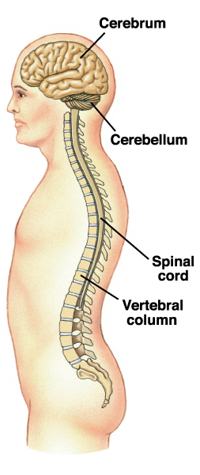
Organization of the Nervous System
2 big initial divisions:
  Central Nervous System
    The brain + the spinal cord
      The center of integration and control
  Peripheral Nervous System
    The nervous system outside of the brain and spinal cord
    Consists of:
      31 Spinal nerves
        Carry info to and from the spinal cord
      12 Cranial nerves
        Carry info to and from the brain

Slide 5
Peripheral Nervous System
Responsible for communication btwn the CNS and the rest of the body.
Can be divided into:
  Sensory Division
    Afferent division
      Conducts impulses from receptors to the CNS
      Informs the CNS of the state of the body interior and exterior
      Sensory nerve fibers can be somatic (from skin, skeletal muscles or joints) or visceral (from organs w/i the ventral body cavity)
  Motor Division
    Efferent division
      Conducts impulses from CNS to effectors (muscles/glands)
      Motor nerve fibers

Slide 6
Motor Efferent Division
Can be divided further:
  Somatic nervous system
    VOLUNTARY (generally)
    Somatic nerve fibers that conduct impulses from the CNS to skeletal muscles
  Autonomic nervous system
    INVOLUNTARY (generally)
    Conducts impulses from the CNS to smooth muscle, cardiac muscle, and glands.

Slide 7
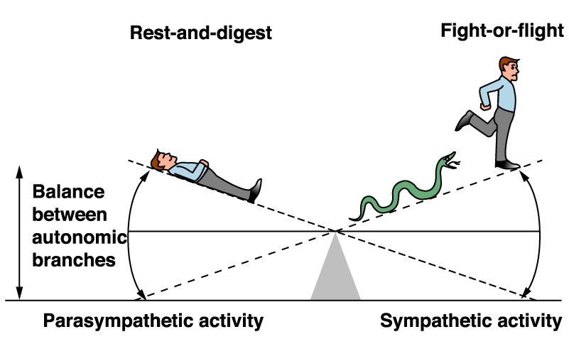
Autonomic Nervous System
Can be divided into:
  Sympathetic Nervous System
    “Fight or Flight”
  Parasympathetic Nervous System
    “Rest and Digest”
      These 2 systems are antagonistic.
      Typically, we balance these 2 to keep ourselves in a state of dynamic balance.
      We’ll go further into the difference btwn these 2 later!

Slide 8
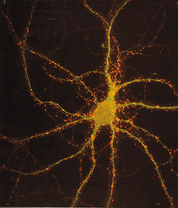
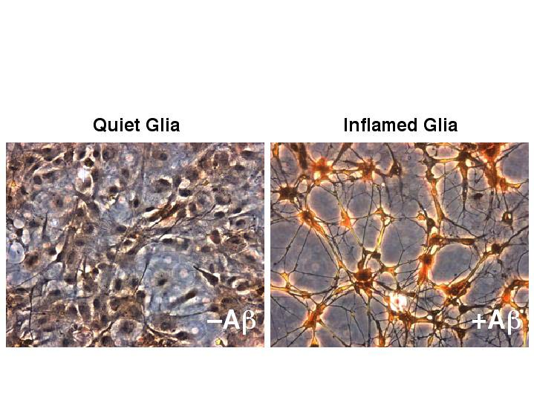
Nervous Tissue
1.
Highly cellular
  How does this compare to the other 3 tissue types?
2 cell types
  Neurons
    Functional, signal conducting cells
  Neuroglia
    Supporting cells
2.

Slide 9
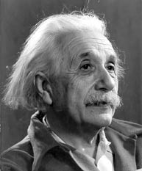
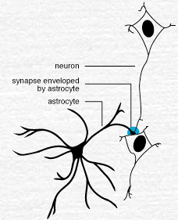
Neuroglia
Outnumber neurons by about
10 to 1 (the guy on the right had an inordinate amount of them).
6 types of supporting cells
  4 are found in the CNS:
Astrocytes
    Star-shaped, abundant, and versatile
    Guide the migration of developing neurons
    Act as K+ and NT buffers
    Involved in the formation of the blood brain barrier
    Function in nutrient transfer

Slide 10
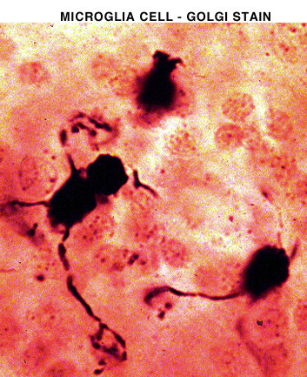
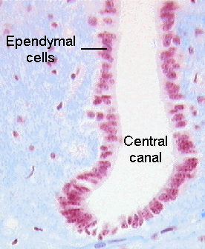
Neuroglia
Microglia
    Specialized immune cells that act as the macrophages of the CNS
    Why is it important for the CNS to have its own army of immune cells?
Ependymal Cells
    Low columnar epithelial-esque cells that line the ventricles of the brain and the central canal of the spinal cord
    Some are ciliated which facilitates the movement of cerebrospinal fluid

Slide 11
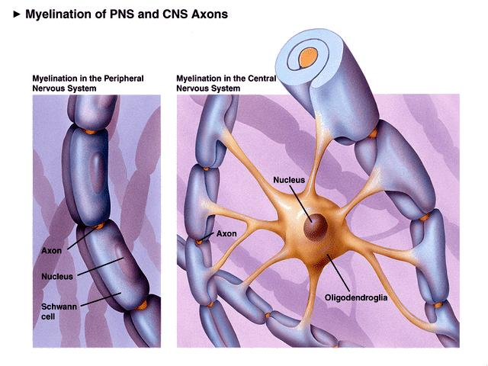
Neuroglia
4. Oligodendrocytes
Produce the myelin sheath which provides the electrical insulation for certain neurons in the CNS

Slide 12
Neuroglia
2 types of glia in the PNS
Satellite cells
    Surround clusters of neuronal cell bodies in the PNS
    Unknown function
Schwann cells
    Form myelin sheaths around the larger nerve fibers in the PNS.
    Vital to neuronal regeneration

Slide 13
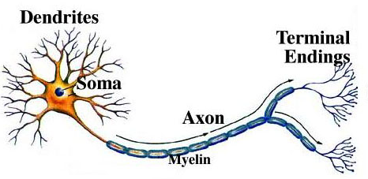
Neurons
The functional and structural unit of the nervous system
Specialized to conduct information from one part of the body to another
There are many, many different types of neurons but most have certain structural and functional characteristics in common:
  Cell body (soma)
  One or more specialized, slender processes (axons/dendrites)
  An input region (dendrites/soma)
  A conducting component (axon)
  A secretory (output) region (axon terminal)

Slide 14
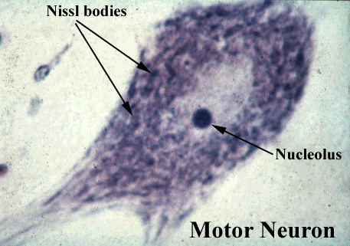
Soma
Contains nucleus plus most normal organelles.
Biosynthetic center of the neuron.
Contains a very active and developed rough endoplasmic reticulum which is responsible for the synthesis of ________.
  The neuronal rough ER is referred to as the Nissl body.
Contains many bundles of protein filaments (neurofibrils) which help maintain the shape, structure, and integrity of the cell.
In the soma above, notice the small black circle. It is the nucleolus, the site of ribosome synthesis. The light circular area around it is the nucleus. The mottled dark areas found throughout the cytoplasm are the Nissl substance.

Slide 15
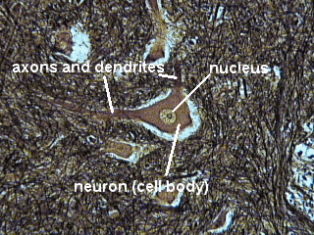
Somata
Contain multiple mitochondria. Why?
Acts as a receptive service for interaction with other neurons.
Most somata are found in the bony environs of the CNS. Why?
Clusters of somata in the CNS are known as nuclei. Clusters of somata in the PNS are known as ganglia.

Slide 16
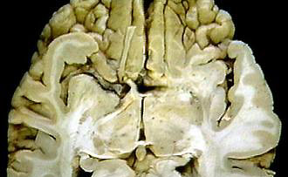
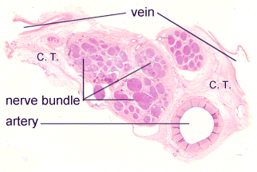
Neuronal Processes
Armlike extensions emanating from every neuron.
The CNS consists of both somata and processes whereas the bulk of the PNS consists of processes.
Tracts = Bundles of processes in the CNS (red arrow)
Nerves = Bundles of processes in the PNS
2 types of processes that differ in structure and function:
  Dendrites and Axons

Slide 17
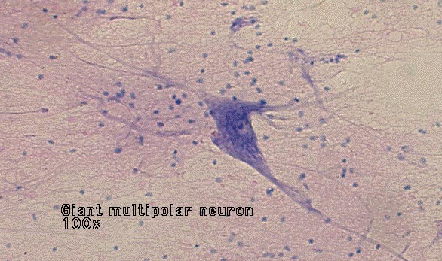
Dendrites are thin, branched processes whose main function is to receive incoming signals.
They effectively increase the surface area of a neuron to increase its ability to communicate with other neurons.
    Small, mushroom-shaped dendritic spines further increase the SA
Convey info towards the soma thru the use of graded potentials – which are somewhat similar to action potentials.
Notice the multiple processes extending from the neuron on the right. Also notice the multiple dark circular dots in the slide. They’re not neurons, so they must be…

Slide 18
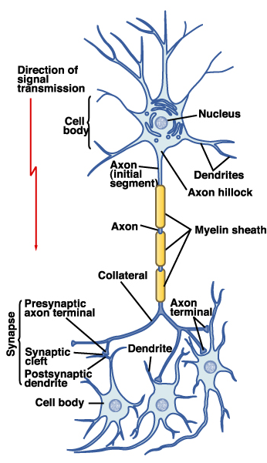
Most neurons have a single axon – a long (up to 1m) process designed to convey info away from the cell body.
Originates from a special region of the cell body called the axon hillock.
Transmit APs from the soma toward the end of the axon where they cause NT release.
Often branch sparsely, forming collaterals.
Each collateral may split into telodendria which end in a synaptic knob, which contains synaptic vesicles – membranous bags of NTs.

Slide 19
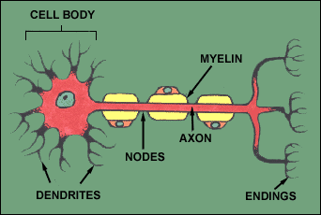
Axons
Axolemma = axon plasma membrane.
Surrounded by a myelin sheath, a wrapping of lipid which:
  Protects the axon and electrically isolates it
  Increases the rate of AP transmission
The myelin sheath is made by ________ in the CNS and by _________ in the PNS.
This wrapping is never complete. Interspersed along the axon are gaps where there is no myelin – these are nodes of Ranvier.
In the PNS, the exterior of the Schwann cell surrounding an axon is the neurilemma

Slide 20
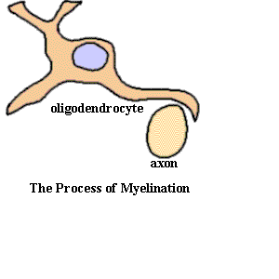
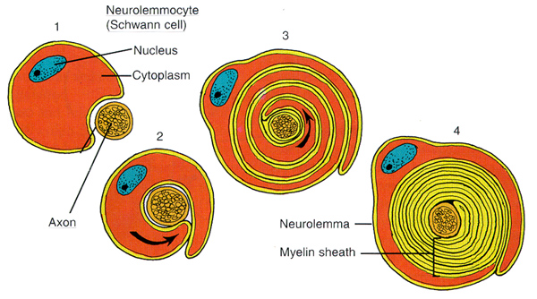
Myelination in the CNS
Myelination in the PNS

Slide 21
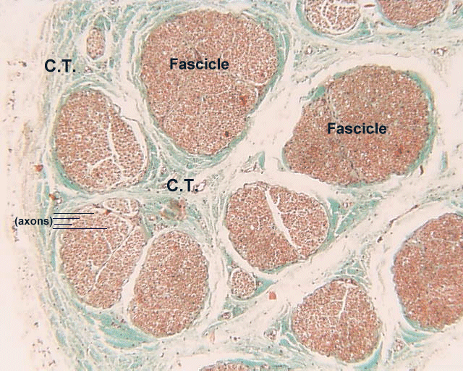
A bundle of processes in the PNS is a nerve.
Within a nerve, each axon is surrounded by an endoneurium (too small to see on the photomicrograph) – a layer of loose CT.
Groups of fibers are bound together into bundles (fascicles) by a perineurium (red arrow).
All the fascicles of a nerve are enclosed by a epineurium (black arrow).

Slide 22
Communication
Begins with the stimulation of a neuron.
  One neuron may be stimulated by another, by a receptor cell, or even by some physical event such as pressure.
Once stimulated, a neuron will communicate information about the causative event.
  Such neurons are sensory neurons and they provide info about both the internal and external environments.
  Sensory neurons (a.k.a. afferent neurons) will send info to neurons in the brain and spinal cord. There, association neurons (a.k.a. interneurons) will integrate the information and then perhaps send commands to motor neurons (efferent neurons) which synapse with muscles or glands.

Slide 23
Communication
Thus, neurons need to be able to conduct information in 2 ways:
  From one end of a neuron to the other end.
  Across the minute space separating one neuron from another. (What is this called?)
    The 1st is accomplished electrically via APs.
    The 2nd is accomplished chemically via neurotransmitters.

Slide 24
Resting Potential
Recall the definition of V_{M} from the muscle lectures.
    Neurons are also highly polarized (w/ a V_{M} of about –70mV) due to:
        Differential membrane permeability to K⁺ and Na⁺
        The electrogenic nature of the Na⁺/K⁺ pump
        The presence of intracellular impermeable anions
Changes in V_{M} allow for the generation of action potentials and thus informative intercellular communication.

Slide 25
Graded Potentials
Let’s consider a stimulus at the dendrite of a neuron.
The stimulus could cause Na⁺ channels to open and this would lead to depolarization. Why?
However, dendrites and somata typically lack voltage-gated channels, which are found in abundance on the axon hillock and axolemma.
  So what cannot occur on dendrites and somata?
Thus, the question we must answer is, “what does this depolarization do?”

Slide 26
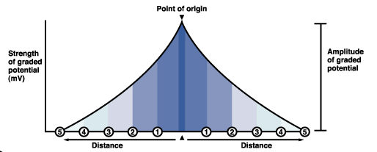
Graded Potentials
The positive charge carried by the Na⁺ spreads as a wave of depolarization through the cytoplasm (much like the ripples created by a stone tossed into a pond).
As the Na⁺ drifts, some of it will leak back out of the membrane.
  What this means is that the degree of depolarization caused by the graded potential decreases with distance from the origin.

Slide 27
Graded Potentials
Their initial amplitude may be of almost any size – it simply depends on how much Na+ originally entered the cell.
If the initial amplitude of the GP is sufficient, it will spread all the way to the axon hillock where V-gated channels reside.
If the arriving potential change is suprathreshold, an AP will be initiated in the axon hillock and it will travel down the axon to the synaptic knob where it will cause NT exocytosis. If the potential change is subthreshold, then no AP will ensue and nothing will happen.

Slide 28
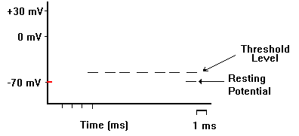
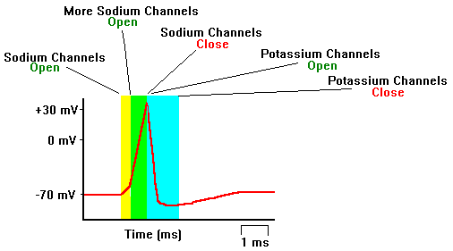
Action Potentials
If V_{M} reaches threshold, Na⁺ channels open and Na⁺ influx ensues, depolarizing the cell and causing the V_{M} to increase. This is the rising phase of an AP.
Eventually, the Na⁺ channel will have inactivated and the K⁺ channels will be open. Now, K⁺ effluxes and repolarization occurs. This is the falling phase.
  K⁺ channels are slow to open and slow to close. This causes the V_{M} to take a brief dip below resting V_{M}. This dip is the undershoot and is an example of hyperpolarization.

Slide 29
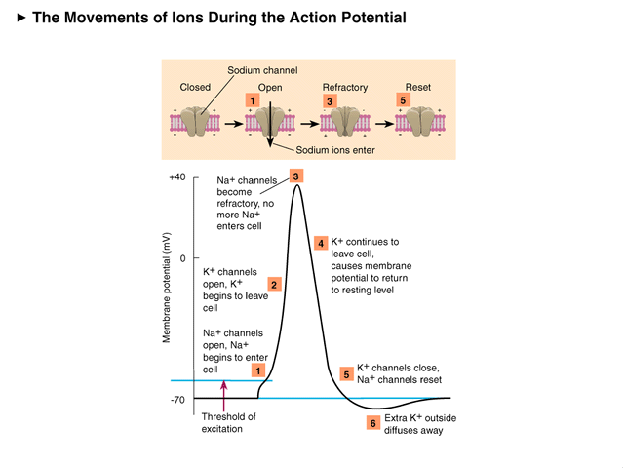

Slide 30
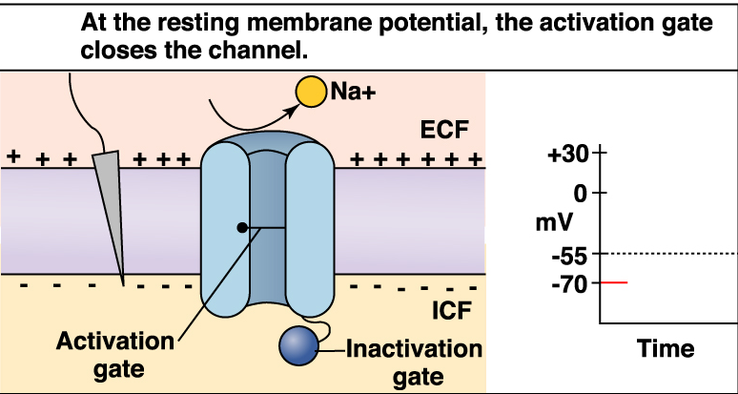
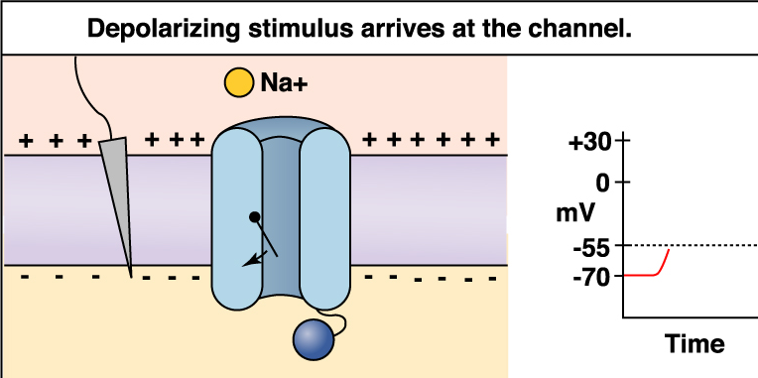
Na⁺ Channels
1
They have 2 gates.
  At rest, one is closed (the activation gate) and the other is open (the inactivation gate).
  Suprathreshold depolarization affects both of them.
2

Slide 31
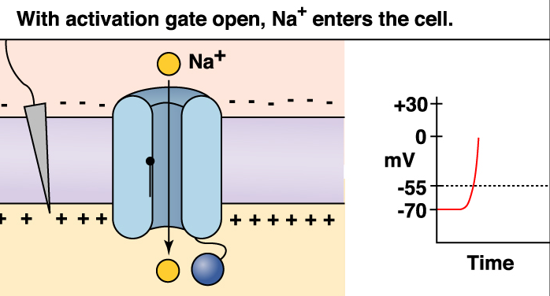
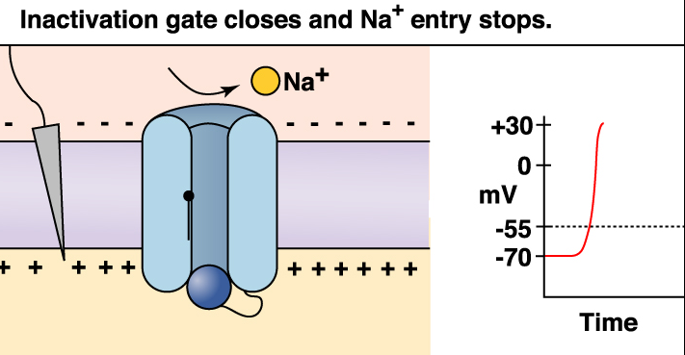
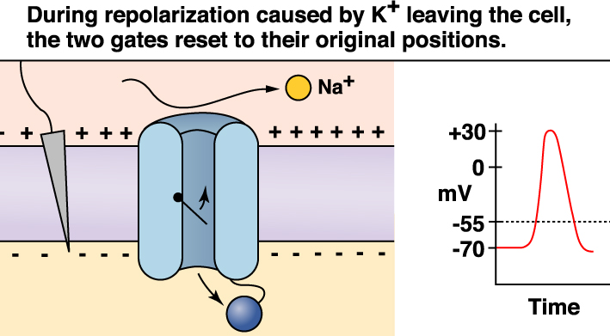
3
4
5

Slide 32
Absolute Refractory Period
During the time interval between the opening of the Na⁺ channel activation gate and the opening of the inactivation gate, a Na⁺ channel CANNOT be stimulated.
  This is the ABSOLUTE REFRACTORY PERIOD.
  A Na⁺ channel cannot be involved in another AP until the inactivation gate has been reset.
  This being said, can you determine why an AP is said to be unidirectional.
    What are the advantages of such a scenario?

Slide 33
Relative Refractory Period
Could an AP be generated during the undershoot?
    Yes! But it would take an initial stimulus that is much, much stronger than usual.
      WHY?
    This situation is known as the relative refractory period.
Imagine, if you will, a toilet.
When you pull the handle, water floods the bowl. This event takes a couple of seconds and you cannot stop it in the middle. Once the bowl empties, the flush is complete. Now the upper tank is empty. If you try pulling the handle at this point, nothing happens (absolute refractory). Wait for the upper tank to begin refilling. You can now flush again, but the intensity of the flushes increases as the upper tank refills (relative refractory)

Slide 34
In this figure, what do the red and blue box represent?
V_{M}
TIME

Slide 35
Some Action Potential Questions
What does it mean when we say an AP is “all or none?”
  Can you ever have ½ an AP?
How does the concept of threshold relate to the “all or none” notion?
Will one AP ever be bigger than another?
  Why or why not?

Slide 36
Action Potential Conduction
If an AP is generated at the axon hillock, it will travel all the way down to the synaptic knob.
The manner in which it travels depends on whether the neuron is myelinated or unmyelinated.
Unmyelinated neurons undergo the continuous conduction of an AP whereas myelinated neurons undergo saltatory conduction of an AP.

Slide 37
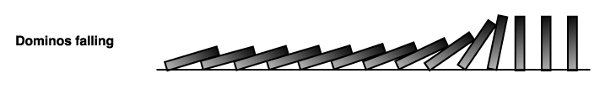
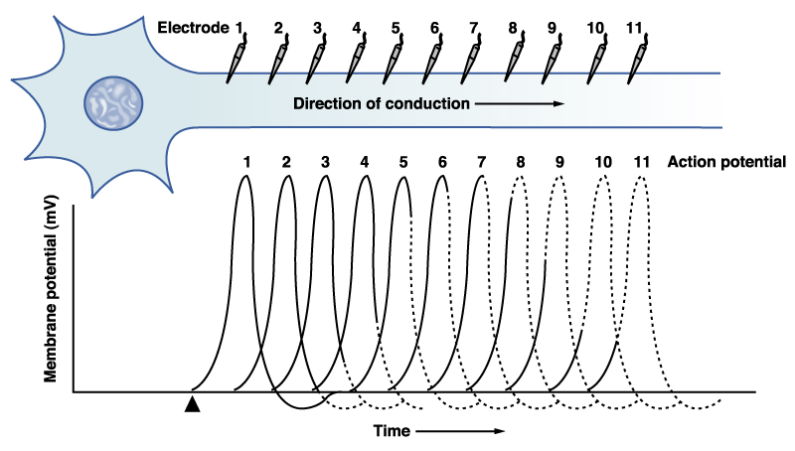
Continuous Conduction
Occurs in unmyelinated axons.
In this situation, the wave of de- and repolarization simply travels from one patch of membrane to the next adjacent patch.
APs moved in this fashion along the sarcolemma of a muscle fiber as well.
Analogous to dominoes falling.

Slide 38
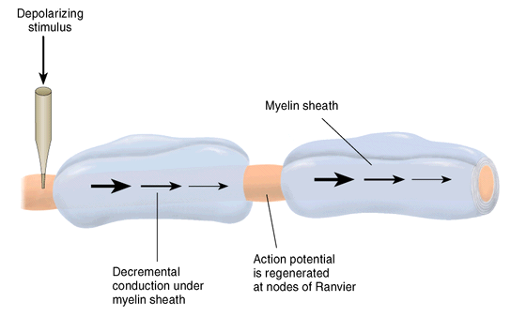
Saltatory Conduction
Occurs in myelinated axons.
Saltare is a Latin word meaning “to leap.”
Recall that the myelin sheath is not completed. There exist myelin free regions along the axon, the nodes of Ranvier.

Slide 39
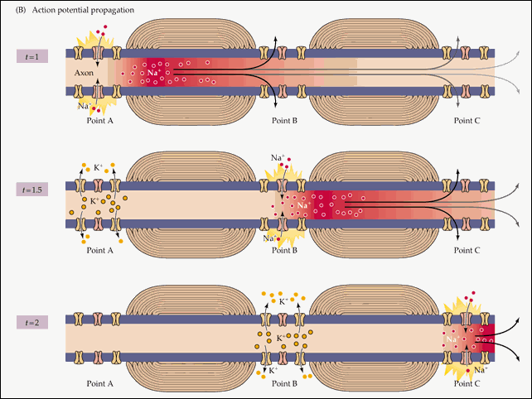

Slide 40
Rates of AP Conduction
Which do you think has a faster rate of AP conduction – myelinated or unmyelinated axons?
Which do you think would conduct an AP faster – an axon with a large diameter or an axon with a small diameter?
The answer to #1 is a myelinated axon. If you can’t see why, then answer this question: could you move 100ft faster if you walked heel to toe or if you bounded in a way that there were 3ft in between your feet with each step?
The answer to #2 is an axon with a large diameter. If you can’t see why, then answer this question: could you move faster if you walked through a hallway that was 6ft wide or if you walked through a hallway that was 1ft wide?

Slide 41
Types of Nerve Fibers
Group A
  Axons of the somatic sensory neurons and motor neurons serving the skin, skeletal muscles, and joints.
  Large diameters and thick myelin sheaths.
    How does this influence their AP conduction?
Group B
  Type B are lightly myelinated and of intermediate diameter.
Group C
  Type C are unmyelinated and have the smallest diameter.
  Autonomic nervous system fibers serving the visceral organs, visceral sensory fibers, and small somatic sensory fibers are Type B and Type C fibers.

Slide 42
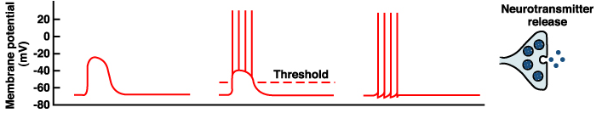
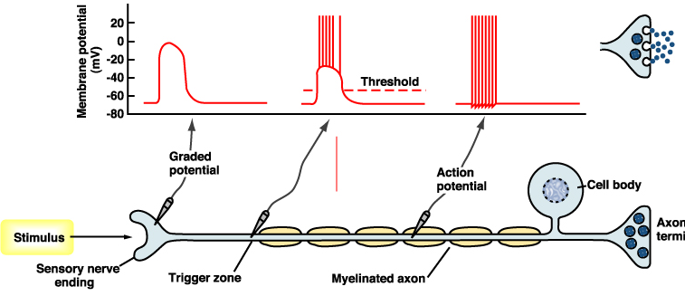
Now we know how signals get from one end of an axon to the
other, but how exactly do APs send information?
  Info can’t be encoded in AP size, since they’re “all or none.”
In the diagram on the right, notice the effect that the size of the graded potential has on the frequency of AP’s and on the quantity of NT released. The weak stimulus resulted in a small amt of NT release compared to the strong stimulus.

Slide 43
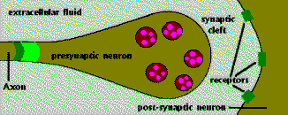
Chemical Signals
One neuron will transmit info to another neuron or to a muscle or gland cell by releasing chemicals called neurotransmitters.
The site of this chemical interplay is known as the synapse.
  An axon terminal (synaptic knob) will abut another cell, a neuron, muscle fiber, or gland cell.
  This is the site of transduction – the conversion of an electrical signal into a chemical signal.

Slide 44
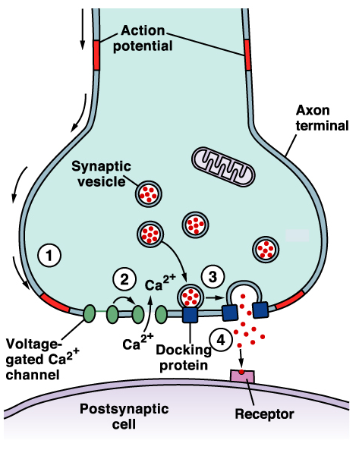
Synaptic Transmission
An AP reaches the axon terminal of the presynaptic cell and causes V-gated Ca²⁺ channels to open.
Ca²⁺ rushes in, binds to regulatory proteins & initiates NT exocytosis.
NTs diffuse across the synaptic cleft and then bind to receptors on the postsynaptic membrane and initiate some sort of response on the postsynaptic cell.

Slide 45
Effects of the Neurotransmitter
Different neurons can contain different NTs.
Different postsynaptic cells may contain different receptors.
  Thus, the effects of an NT can vary.
Some NTs cause cation channels to open, which results in a graded depolarization.
Some NTs cause anion channels to open, which results in a graded hyperpolarization.

Slide 46
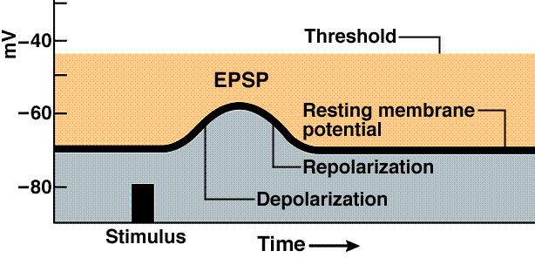
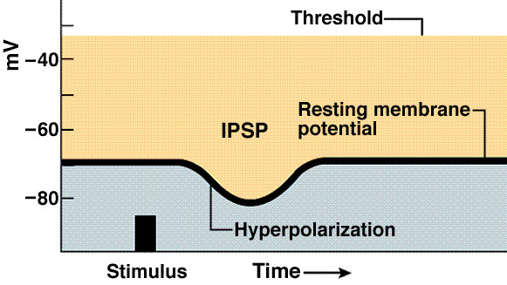
EPSPs & IPSPs
Typically, a single synaptic interaction will not create a graded depolarization strong enough to migrate to the axon hillock and induce the firing of an AP.
  However, a graded depolarization will bring the neuronal V_{M} closer to threshold. Thus, it’s often referred to as an excitatory postsynaptic potential or EPSP.
  Graded hyperpolarizations bring the neuronal V_{M} farther away from threshold and thus are referred to as inhibitory postsynaptic potentials or IPSPs.

Slide 47
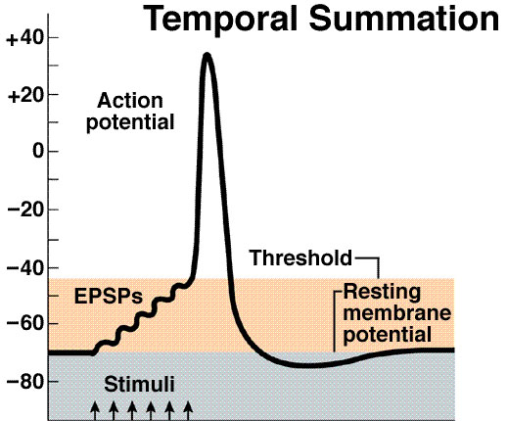
Summation
One EPSP is usually not strong enough to cause an AP.
However, EPSPs may be summed.
Temporal summation
  The same presynaptic neuron stimulates the postsynaptic neuron multiple times in a brief period. The depolarization resulting from the combination of all the EPSPs may be able to cause an AP.
Spatial summation
    Multiple neurons all stimulate a postsynaptic neuron resulting in a combination of EPSPs which may yield an AP

Slide 48
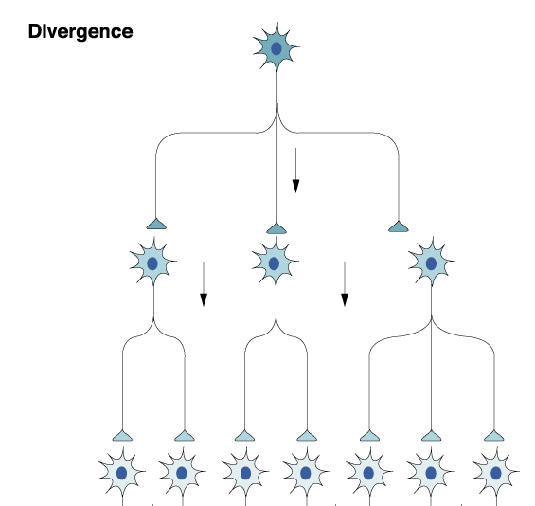
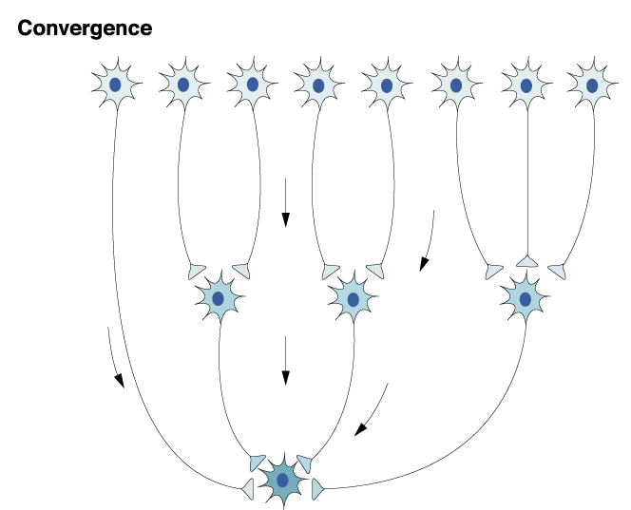
Communication btwn neurons is not typically a one-to-one event.
  Sometimes a single neuron branches and its collaterals synapse on multiple target neurons. This is known as divergence.
  A single postsynaptic neuron may have synapses with as many as 10,000 postsynaptic neurons. This is convergence.
  Can you think of an advantage to having convergent and divergent circuits?

Slide 49
Neurons may also form reverberating circuits.
    A chain of neurons where many give off collaterals that go back and synapse on previous neurons.
      What might be a benefit of this arrangement?

Slide 50
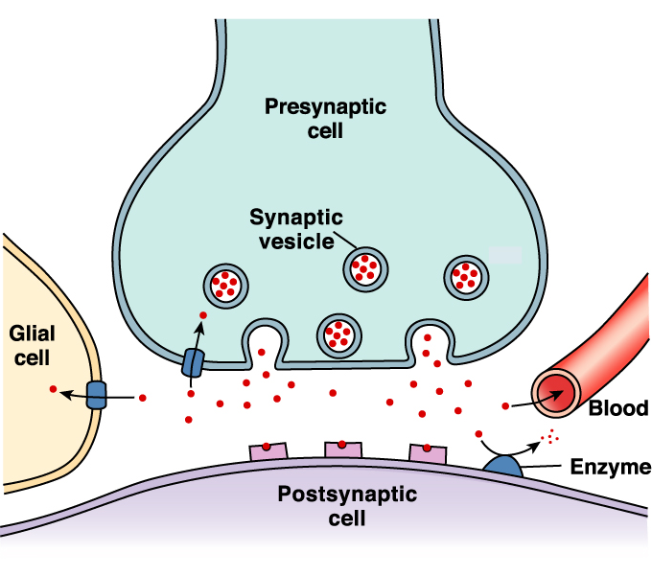
Neurotransmitter Removal
Why did we want to remove ACh from the neuro- muscular junction?
How was ACh removed from the NMJ?
NTs are removed from the synaptic cleft via:
  Enzymatic degradation
  Diffusion
  Reuptake

